Slide 1
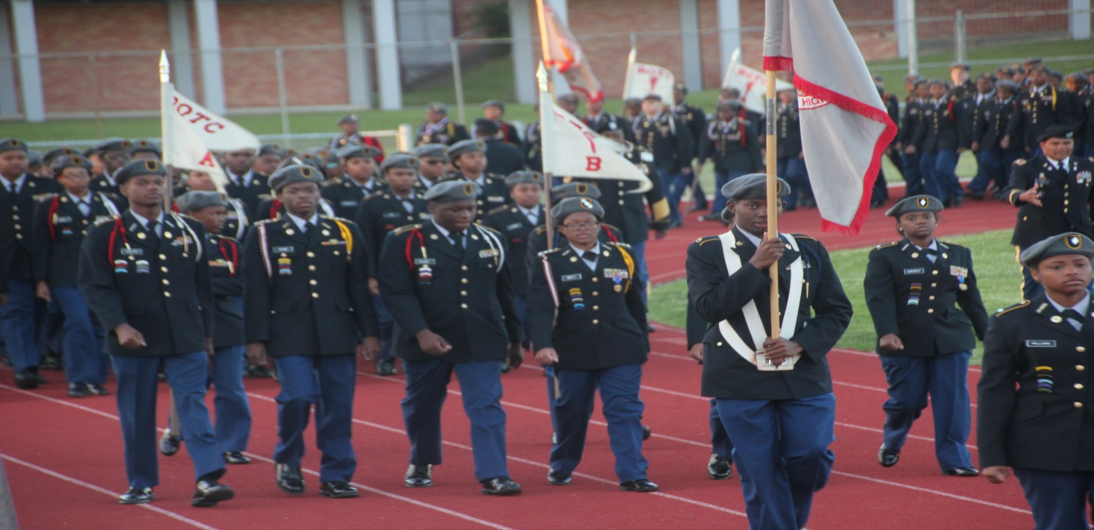
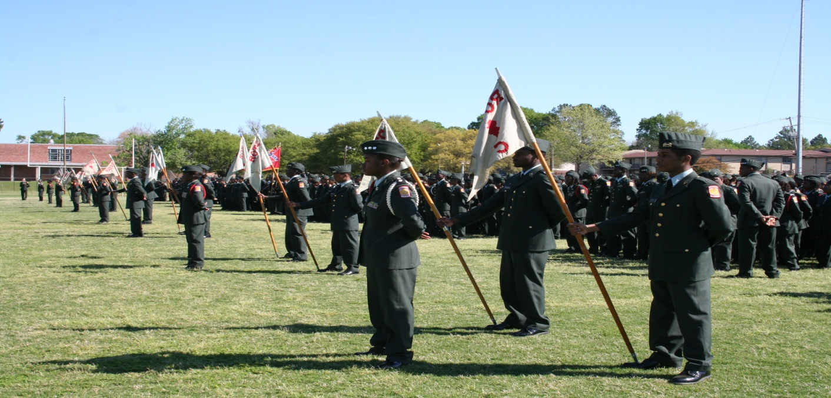
JACKSON PUBLIC SCHOOLS JROTC
BRIGADIER GENERAL AMANDA I. AZUBUIKE Deputy Commanding General U.S. Army Cadet Command Visit 6 DEC 23 JPS JROTC
“Motivating young people to be better citizens”

Slide 2
JPS JROTC Briefing Agenda
JROTC Mission Statement
JPS Mission and Core Values
JROTC History in Jackson
JPS JROTC Organization Chart
Building Leaders for Life
JPS JROTC Staff and Enrollment Numbers
Graduated Seniors
5 Year Cadet Development Plan
Pitfalls to Personal Development
Funding of JPS JROTC
JPS JROTC Integrated-Curricular Activities / Programs
Conclusion and Questions

Slide 3
JROTC Mission
…Motivate Young People Through Caring Leadership
and Positive Influence to Be Better Citizens For Life-Long Service to the Community and to produce outstanding scholars.

Slide 4
JPS Mission and Core Values
“We develop scholars through world-class learning experience to attain an exceptional knowledge base, critical and relevant skill sets, and the necessary dispositions for great success.”
Equity
Our vision of equity, put simply, is "all means all." We ensure equity by celebrating each scholar's individuality, interests, abilities and talents; providing each scholar in each school with equitable access to high-quality instruction, courses, and resources; and holding high expectations for all scholars to graduate college-ready and career-minded. Similarly, we recognize and value the individual abilities, experiences and talents of our staff; providing all staff with equitable access to opportunities for development and growth; and ensuring that such opportunities are provided through clear and transparent processes.
Excellence
High expectations for our scholars help to prepare them for college and career paths. High expectations from and for all adults foster ownership, consistency, and transparency. Every member of our district performs with an attention to detail and the quality that each task demands in order to achieve great outcomes.
Growth Mindset
Our leaders—scholars and staff—thrive in environments where belief in their abilities is affirmed. Everyone in the organization embraces the ideal that effort and perseverance lead to success.
Relationships
It is essential to develop relationships through mutual respect of culture, social context, and community. This allows us to create a community of safety, trust, productive vulnerability, and genuine connection as we celebrate successes and value opportunities for constructive feedback.
Relevance
Scholars experience relevant education that is engaging, motivating, and inspiring, leading to a lifelong commitment to learning. Our scholars must learn to connect with each other, the larger community, and the 21st-century world, ultimately developing agency to contribute to positive change in Jackson, in Mississippi, and in the world.
Positive & Respectful Culture
Scholars and staff thrive in learning environments where growth and achievement are the highest priorities and climates are safe, positive, and respectful. These environments engage and excite all scholars, leaving them hungry for more knowledge. All adults contribute to a positive and respectful culture allowing them to experience more productivity, increased retention, and joy at work.

Slide 5
JROTC Districtwide Goals
Goal 1: By October 1 of each academic school year, a minimum of 50% of LET 1 cadets will advance to LET 2, a minimum of 35% of those LET 2 cadets will advance to LET 3, and a minimum of 40% of those LET 3 cadets will advance to LET 4.
Conducted JROTC demonstrations, displays, information briefings, and JROTC orientations to all 9th, 10th, 11th, and 12th graders and parents.
Conducted follow-up visits to assigned feeder pattern middle schools
Requested SAM data for all incoming 9th-grade cohort students in JROTC from counselors and data analysts. (Rosters)
Implemented the Cadet Personal Development Plan (CPDP) for all 9th graders for the first semester and maintained CPDP for all other cadets.
Fostered positive social interactions with parents, students, staff, and community through School Status
Developed cohort tracker to monitor student transitions from one LET level to the next LET level
Goal 2: By May 30, 2024, Junior JROTC cadets (LET 3) will have an average ACT composite score increase from 15.42 to 19.
Improve ACT scores through cooperation from the following: a. faculty b. staff, c. JROTC cadre, d. parents, e. Get2College, d. Majority Clarity, e. use Mastery Prep for ACT prep and f. use March2Success prep
Identified all 11th graders and determined their Practice ACT scores in the first semester
Conducted ACT/SAT workshops/practice, tests and completed high school ACT pretests
Thrive Goal: By April 15, 2024, 10% of JROTC cadets with Individualized Education Program (IEP) will hold key leadership positions and attend all STEM summer camps.
Meet with individual school counselors to promote the JROTC programs.
Use School Status and the Office of Public Engagement to regularly share pertinent information related to the JROTC program.
All JROTC instructors will participate in each cadet’s annual IEP review.
Attend and participate in the monthly Climate and Wellness meetings.

Slide 6
JROTC History In Jackson, MS
Central High School – 1936
Lanier - 1971
Murrah - 1977
Wingfield - 1977
Callaway - 1978
Forest Hill – 1978
Provine – 1979
Jim Hill – 1980
Bailey Magnet – 1993 (JROTC unit closed – June 2012)
Powell Middle School Junior Cadet Corps - 2016
87 Years in Jackson
And Still Going
Strong
Notes:
6
Title 10 USC 2031 authorizes JROTC
Title 10 USC 4651(Arms, Tentage and Equipment: Educational institutions not maintaining units of ROTC) authorizes NDCC

Slide 7
JPS JROTC Organization Chart SY23-24
JACKSON PUBLIC SCHOOL DISTRICT ASSISTANT SUPERINTENDENT HIGH SCHOOLS
JROTC-SY 2023/2024
All JROTC instructors are
retired Army Veterans with a minimum 20 years’ experience and world view perspective.
U.S. ARMY CADET COMMAND
U.S. ARMY 6th Brigade ROTC
JROTC DIRECTOR, ARMY INSTRUCTION: COL Fredrick Brown
PROPERTY OFFICER: SFC Roderick Moore OPERATIONS NCO: 1SG Charles Weathersby SECRETARY: Ms. Kimbra Smith
CALLAWAY HS SAI: LTC Rodney Parker
FOREST HILL HS SAI: LTC Linda Prowell
JIM HILL HS SAI: MAJ Paul McKnight Pending CNACI
LANIER HS SAI: COL Regal Perry
MURRAH HS SAI: MAJ Robert Morton
PROVINE HS SAI: MAJ Daniel McGee
WINGFIELD HS SAI: LTC Derrick Davis
AI: SFC Kenneth Laster
AI: SFC Rodney Johnson
AI: Vacant
AI: 1SG Zelon Odoms
AI: VACANT
AI: SFC Montrell McGruder
AI – APPROVAL Granted for 4th instructor
AI: 1SG Gayle Anderson
AI: MSG Carlos Parker
AI: Vacant
AI: MSG Gary Pope
AI: Vacant
AI: SLOT LOST DUE TO DECREASED ENROLLMENT, initiating the 8th Grade program
AI: MSG Gregory Jackson
AI: Vacant SFC Gary Lewis Pending Approval
AI: SFC Mcglaston
AI: Vacant CW2 Suzzanne Smith-Tyler pending Approval
AI: 1SG Damon Williams: Pending Loss to JSU
AI: CW4 Melba Mosley
AI: Vacant
NOTE:
SAI: Senior Army Instructors - 7
AI: Army Instructors – 17
DAI: Director, Army Instruction Office – 3
Secretary – 1
Powell Middle School JCC Instructors - 1
POWELL MS
CPO Earnest Terry

Slide 8
ACADEMIC COURSEWORK
• Citizenship In Action • Leadership Theory & Application
• Foundations for Success • Wellness, Fitness & First Aid • Geography, Map Skills and
Environmental Awareness • Citizenship in American History
and Government
• Service-Learning Projects
• Academic Credit – PE & Health
JPS JROTC
TEAMS / COMPETITIONS
• Drill Team/Color Guard
• Cadet Challenge/Physical Fitness
• Academic/JROTC Leadership and
Academic Bowl
• Adventure Training
• Cadet of the Year
Fully Engaged:
Building Leaders For Life
Exposure – Experience – Knowledge – Reflection - Time
LEADERSHIP CAMPS
• JROTC Cadet Leadership Challenge
• STEM Camp - Mississippi State
University (Engineering)
• STEM Camp-William Carey
University - (Health Careers)
• Camp Hood Boy Scout • Environmental Learning Center
• National Flight Academy
ENRICHMENT EXPERIENCES
• Boys/Girls State – MSU
• Chemistry/ICN (STEM) – JSU
• Hugh O’Brien Leadership
• MOWW Youth Leadership • Financial Literacy • Military Academy/SROTC Day • Cadet Leadership and Staff
Development Course
• VA Hospital Volunteer Program • Consolidated Military Gala • Annual Accreditation Program
• Adopt-A-School Program
• Annual Veterans Day Program
at each school
“Motivating Young People to be
Better Citizens. “
COMMUNITY SERVICE
• Stop Hunger NOW
• Color Guard Presentations
• Habitat for Humanity
• Veterans Hospital Visit
• Nursing Home Visits
• City Wide Cleanup
• New Hope Baptist Church
Community Health Fair
• JPS Convocation
• JPS 9th Grade Career Fair
PARTNERS IN LEARNING
• Army National Guard • Stand and Serve • 100 Black Men - Jackson
• Mississippi State University – leaderSTATE • JMAA • USM STEM
• Jackson State University Interdisciplinary Nanotoxicity Center
• William Carey University – Institute of Health Careers
• Education Services Foundation/Get2College Center
• Fund II Foundation Inter-City Youth at Lincoln Hills, Colorado (Mr. Robert Smith)
COLLEGE ORIENTATION VISITS • Alcorn State University • Jackson State University • Mississippi State University
• The University of Mississippi • University of Southern Mississippi
• Graduates are prepared to succeed in postsecondary options and career pathways.
• Make decisions that promote positive social emotional, and
physical health. • Value the role of the military as they lead others to succeed in a
diverse and global workforce.
• Act with integrity and personal accountability as they lead
others to succeed in a diverse and global workforce. • Engage in civic concerns that impact the community and society
at large.
PROGRAM OUTCOMES
PARADES
• Alcorn State University
• Jackson State University
• City of Jackson Christmas
• Martin Luther King Day
• Veterans Day
FIELD TRIPS
• Vicksburg, MS-National Military Park
• Jackson, MS / Memphis, TN - Civil Rights Museum
• Mobile, AL- Battleship Memorial
• New Orleans, LA – World War II Museum
• Hattiesburg, MS – Camp Shelby Military Museum

Slide 9
JPS JROTC Staff and Enrollment Numbers
School / Instructors As of 19 Sep 2023 | Cadets / Total Students SY23/24 numbers | % of School Enrollment SY23/24 numbers
Callaway (3) | 178 / 926 | 19.22
Forest Hill (3) | 266 / 985 | 27.00
Jim Hill (2) | 196 / 876 | 22.37
Lanier (2) | 190 / 610 | 31.15
Murrah (2) | 200 / 1347 | 14.85
Provine (2) | 132 / 733 | 18.00
Wingfield (3) | 167 / 568 | 29.40
JPS Totals (17) | 1,329 / 6,045 | 23.14
Salary for all Instructors are cost-shared
between Army and School District

Slide 10
JPS Enrollment 2014 - 2023
Total Enrollment
35,000
30,000
28,778
27,801
26,852
25,426
25,000
23,783
22,401
20,619
19,676
20,000
18,874
15,000
10,000
5,000
0
2014-2015
2015-2016
2016-2017
2017-2018
2018-2019
2019-2020
2020-2021
2021-2022
2022-2023

Slide 11
JROTC SY 2022-2023 Graduated Seniors
SY 2023-2024 Seniors: 199
SY 2022-2023 Percentage Seniors that Graduated: 99%

Slide 12
5 YEAR CADET PERSONAL DEVELOPMENT PLAN
NAME_____________
CAREER______________
Experience
Knowledge
Reflection
Time
Development
Y
12th Grade | ACH
 | Y or N
Intense Focus on Goals
On track to Graduate
GPA 3.0 - 3.3+
Finances/Budget/ Savings
Primary Staff Position
Submit College Applications (6+)
Receive LoA (6+)
Apply for Scholarships (10+)
Apply for Financial Aid (Spr)
ACT Improvement (21-24+)
CC Score 85 % ea event
Community Service (3)
Service Learning (1)
Visit College Campuses (4)
Summer Internship
Review Transcript
School Extra Curricular Activities
JROTC Teams (Physical Exam)
ADA (176+ Days)
Active involvement in faith based institution
Y
9th Grade | ACH
 | Y or N
Establish Meaningful Goals
Attain Minimum GPA of 2.5-2.75+
Attain Minimum CC Score 50% in each event
Participate on JROTC Team (Get Physical Exam)
Participate in Extra Curricular School Activities
Demonstrate Written Communication Skills (3)
Demonstrate Oral Communication Skills (3)
Perform Community Service Activity (1)
Participate in Service-Learning Project ( 1)
Demonstrate Teamwork
Review Transcript Qtrly (Update Shot Records)
Attend at least one Formal Social Event
Attain Rank of PFC
Participate in Educational Field Trip (Top 25)
ADA (176+ Days)
Attend JCLC (Top 10)
Active involvement in faith based institution
10th Grade | ACH
 | Y or N
Review and Update Goals
Attain Minimum GPA of 2.75-3.0+
Attain Minimum CC Score of 65% in each event
Participate on JROTC Team (Get Physical Exam)
Participate in Extra Curricular School Activities
Demonstrate Improved Written Communication Skills (4)
Demonstrate Improved Oral Communication Skills (4)
Attend 2 ACT/SAT Workshops
Demonstrate Knowledge in First Aid
Perform Community Service Activity (2)
Participate in Service-Learning Project (1)
National Honor Society
Review Transcript Qtrly
Pass SATP
Obtain JROTC PE Credit
Attain Rank of CPL/SGT
Demonstrates Teamwork
Selected as a Squad Leader
Attend JCLC (up to 5 cadets)
Attend STEM (5 cadets)
Attend HOBY (1 cadet)
Attend at least one Formal Social Event and Field Trip
ADA (176+ Days)
Active involvement in faith Based institution
11th Grade | ACH
 | Y or N
Review and Update Goals
Attain Minimum GPA of 2.9 -3.0+
Attain Minimum CC Score 75% per event
Participate on JROTC Team (Get Physical Exam)
Participate in Extra Curricular School Activities
Pass SATP
ACT Testing 19 -21 (2)
ASVAB /PSAT
Submit College Applications (3)
Apply for Scholarships (5)
Visit College Campuses (2)
Review Transcript Qtrly
Review Graduation Req
NEFE/Personal Budget/Savings
Community Service (3
Service Learning (1)
Career Exploration
National Honor Society
Attend STEM (up to 5)
Attend Girls State (2 cdts)
Attend Boys State (2 cdts)
Obtain JROTC Health Credit
Attend at least one Formal Social Event and Field Trip
Company Level Positions
Attain rank of LT/CPT/1SG/SFC
ADA (176+ Days)
Active involvement in faith-based institution
Post H.S. | ACH
 | Y or N
Intense Focus on Goals
Community College
4- Year University
Trade School
Technical School
Next 5-Year Plan
GPA 3.0+
Maintain Height/weight standard
Maintain high Level of physical fitness
Active involvement in faith based institution
Signature/Date (Cadet)
________________
Signature/Date (Cadre)
_____________________

Slide 13
Pitfalls to Personal Development
AVOID
DANGEROUS
PITFALLS
STAY
STRONG
Y
Signature/Date
___________________
Y
9th Grade
Low Academic Achievement
Teen Pregnancy/Early Sexual Involvement
Negative Peer Pressure
Lack of Self Discipline
Poor diet, exercise and sleeping habits
Poor Time Management
Procrastination
Poor Refusal Skills
Negative Attitude/Behavior
Drugs, Alcohol or Tobacco
Unnecessary Stress
ISS/Suspensions
Gang Activity or Mentality
Unexcused Absences
Lack of Consideration of Others
Low Self Esteem
Unbalanced Life
Failure to Plan for the Future
10th Grade
Low Academic Achievement
Teen Pregnancy/Early Sexual Involvement
Negative Peer Pressure
Lack of Self Discipline
Poor diet, exercise and sleeping habits
Poor Time Management
Procrastination
Poor Refusal Skills
Negative Attitude/Behavior
Drugs, Alcohol or Tobacco
Unnecessary Stress
ISS/Suspensions
Gang Activity or Mentality
Unexcused Absences
Lack of Consideration of Others
Low Self Esteem
Unbalanced Life
Too Much Time on Part-Time Job
Fail SATP
11th Grade
Low Academic Achievement
Teen Pregnancy/Early Sexual Involvement
Negative Peer Pressure
Lack of Self Discipline
Poor diet, exercise and sleeping habits
Poor Time Management
Procrastination
Poor Refusal Skills
Negative Attitude/Behavior
Drugs, Alcohol or Tobacco
Unnecessary Stress
ISS/Suspensions
Gang Activity or Mentality
Unexcused Absences
Lack of Consideration of Others
Low Self Esteem
Unbalanced Life
Too Much Time on Part-Time Job
Fail SATP
12th Grade
Low Academic Achievement
Teen Pregnancy/Early Sexual Involvement
Negative Peer Pressure
Lack of Self Discipline
Poor diet, exercise and sleeping habits
Poor Time Management
Procrastination
Poor Refusal Skills
Negative Attitude/Behavior
Drugs, Alcohol or Tobacco
Unnecessary Stress
ISS/Suspensions
Gang Activity or Mentality
Unexcused Absences
Lack of Consideration of Others
Low Self Esteem
Unbalanced Life
Too Much Time on Part-Time Job
Failure to Plan
Post H.S.
Full-Time Student/Employee
Teen Pregnancy/Early Sexual Involvement
Stress
Financing College
Negative Peer Pressure
Unhealthy Social Life
Too Independent
Bad Decision-Making
Home Sick
Failure to Plan Ahead
Excessive Absences
No Accountability
Procrastination
Lack of Self Discipline
Poor diet and exercise habits
Poor Refusal Skills
Signature/Date (Cadre)
___________________
Signature/Date (Cadet)
___________________

Slide 14
Funding of JPS JROTC
Funding from Army
$2,641,048.07
Instructor Salaries (Reimbursement to the District)
Classroom Equip. & Uniforms
Operational Maintenance
Replacement Uniforms & Cadet Meals / Transportation
Laundry Contract: $61,184.75
MSU STEM Contract: $1,650,821
WCU STEM Contract: $85,532
JCLC Camp Shelby
National Flight Academy, Pensacola Naval Air Station, FL: $500,000
Significant Contributions from Partners in Learning
$26,000 – JSU Interdisciplinary Nanotoxicity Center Summer Institute
American Legion Post 1776 – Sponsor cadets to attend (14) Boys / (14) Girls State
$10,000 plus - Jackson Municipal Airport Authority (JMAA) – Full week of engagement Aviation training
Notes:
14

Slide 15
JPS JROTC Special Leadership Programs
Exposure – Experience – Knowledge – Skills for Life

Slide 16
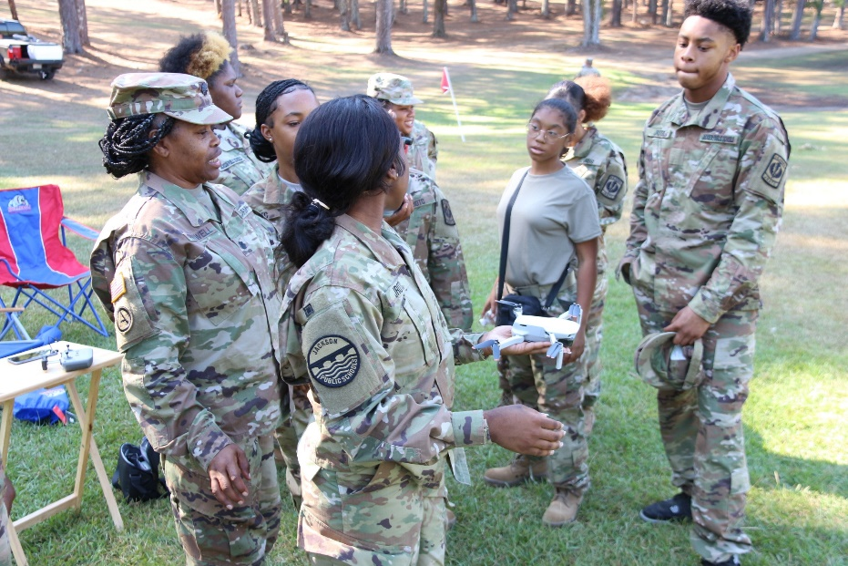
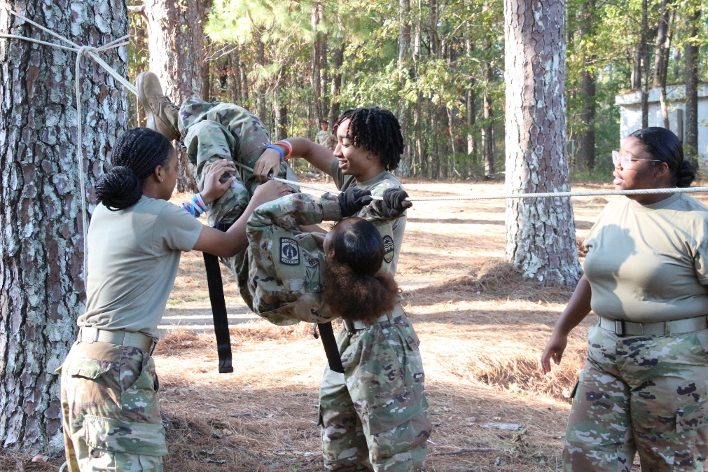
JPS JROTC Integrated-Curricular Activities
Adventure Training Unit
Cadets learn outdoor survival skills in an outdoor environment (CPR, Map Reading, Rope bridge, Drones)
12 – 15 cadets per school
(Mid-Sept. Annually: JPS Environmental Learning Center)
100 JPS cadets participate
Army pays majority of expenses

Slide 17
JPS JROTC Integrated-Curricular Activities Cont.
Cadet Challenge (Wellness, Fitness & Healthy Lifestyle)
All cadets required to participate to improve strength, cardio-vascular endurance & promote healthy lifestyle
JPS hosts annual competition - (Mid-Oct. Annually– Hughes Field)
Competition based on President’s Challenge / Physical Fitness Program
Five events: Pull-ups, Shuttle Run, Curl-ups, V-Sit & Reach, 1-Mile Run/Walk
7 – 12 person competitive team at each school
Top teams also compete with other schools in region and state

Slide 18
JPS JROTC Integrated-Curricular Activities Cont.
Drill & Ceremonies (Teaches discipline, leadership, and team building)
All cadets are required to participate in this training
20 – 25 person Drill Team at each school
JPS hosts annual competition (Mid-Oct. Annually– Cardoza Middle School and or Forest Hill High School)
Teams also compete with other schools in the state and region competition
Top teams compete in national competition – Richmond, VA
Forest Hill, Wingfield and Murrah selected to participate in state competition in 20 January 2024 in Ocean Springs, MS

Slide 19
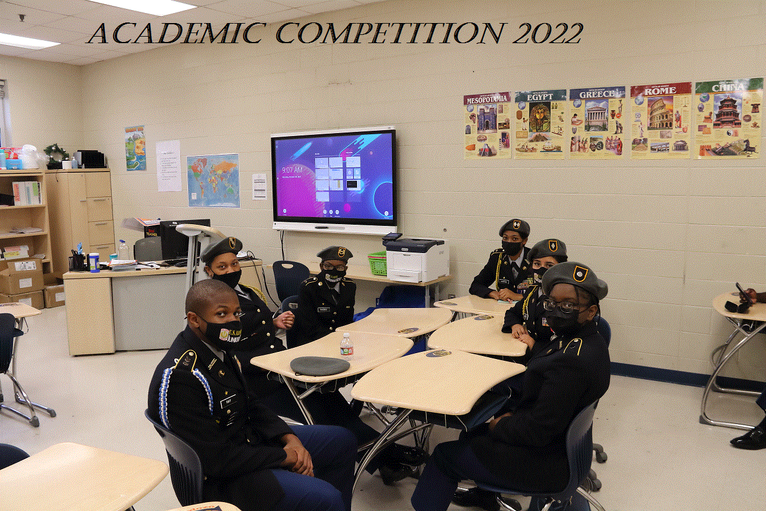
JPS JROTC Integrated-Curricular Activities Cont.
Academic Competitions (Reinforces - JROTC Curriculum Knowledge and Current Event Questions)
Five to seven person Academic Team at each school
JPS hosts annual competition using CMV3 (Mid-Oct Annually– Cardoza Middle School or Forest Hill High School)
Army hosts competition via internet annually and top teams travel to Washington, D.C.
JPS teams selected for Washington, D.C. trip in recent years – (Murrah, Jim Hill, and Forest Hill)
Army pays all expenses

Slide 20
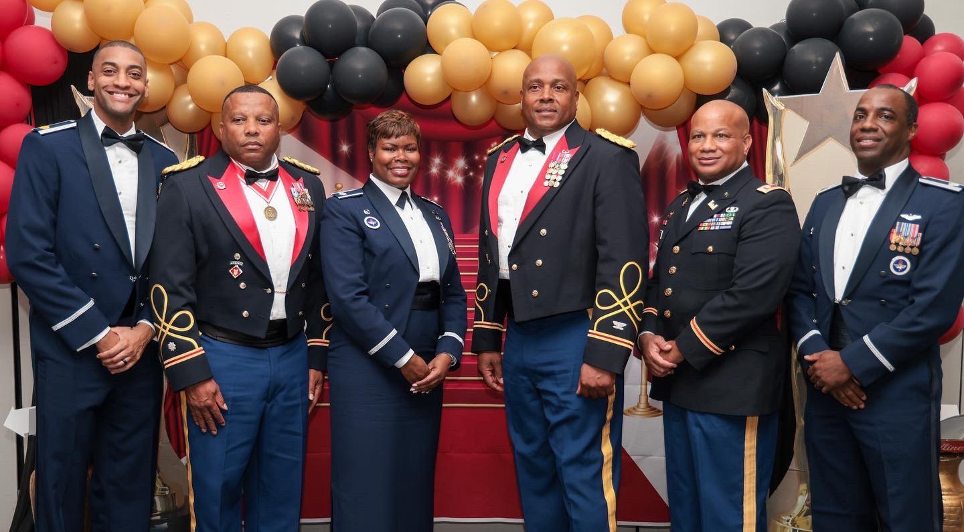
JPS JROTC Integrated-Curricular Activities Cont.
JROTC Military Gala: 15 December 2023 – Teaches Planning Skills, Social Responsibilities & Etiquette
Formal social event conducted at the Jackson Convention Complex, 3rd Friday in Dec annually
The program will consist of:
Formal Receiving Line
Posting of Colors, National Anthem and Invocation
Welcoming Remarks, History of JROTC and History of Military Dining-Out
Toasts, Dinner, 20 Minute Break and Guest Speaker
Closing Remarks, Retiring of Colors, Benediction and finally Dancing
Average annual attendance is 950 (cadets, parents, alumni, teachers, administrators and supporters)
Cost is $36.00 per person (cadets conduct fund raisers throughout the year to help off set their cost)

Slide 21
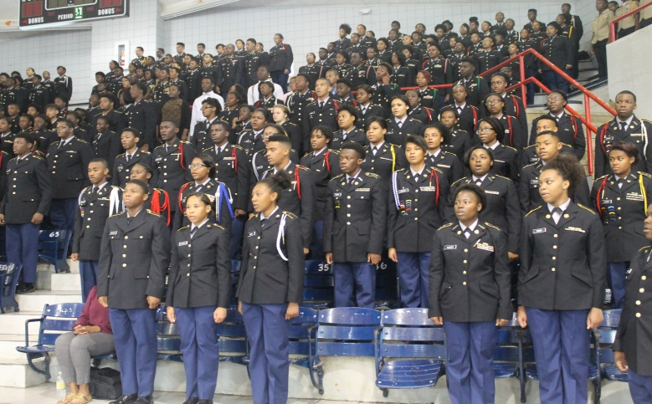
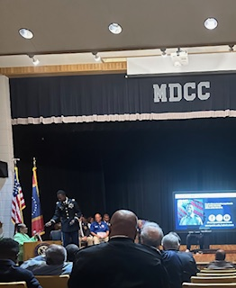
JPS JROTC Special Programs
JROTC Academy Day
Conducted mid-October annually in gymnasium at Forest
Hill High School
Over 300 cadets from across JPS, Pearl, Hazlehurst and
Vicksburg attend this event.
Purpose is to showcase Institutions of Higher Learning and
Advanced Manufacturing opportunities to students who are
looking to further their education, pursue careers in the military or
enter the workforce.
Congressman Bennie Thompson host annual Academy Day. Participants include representatives from all U.S. Military Academies, JSU, ASU, MSU, USM, Ole Miss, Georgia Military College, Marion Military Institute, Mississippi Army National Guard, Hinds Community College and Industry Reps.
At the conclusion of the forum, representatives will get a chance to meet and disperse informational materials to JROTC cadets and other attendees in a college fair format.
Currently two students graduating from West Point in December 2023
One student graduating from Air Force Academy in May 2023
One student graduating from Marion Military Institute in December 2023

Slide 22
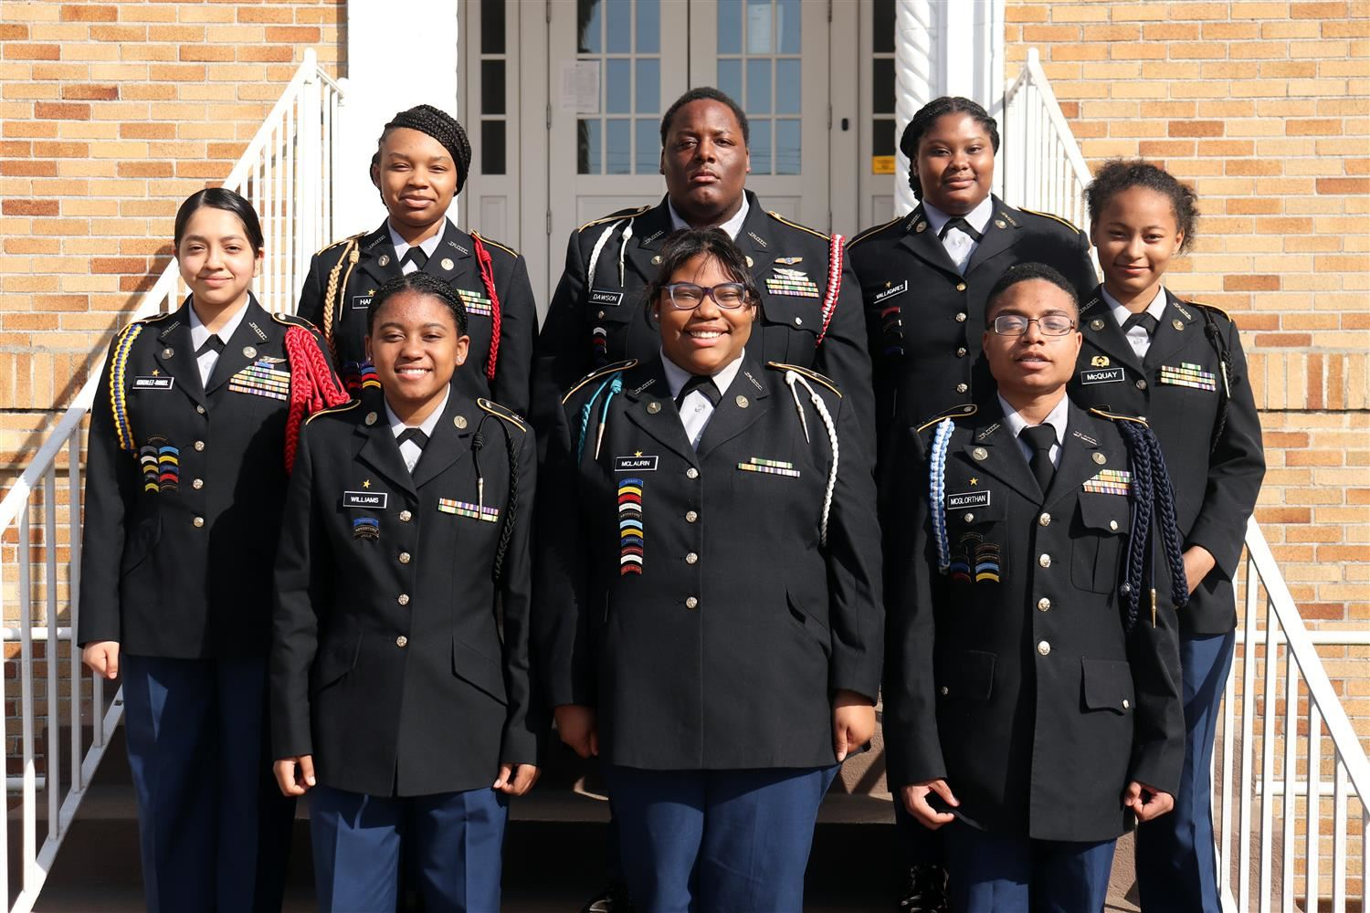
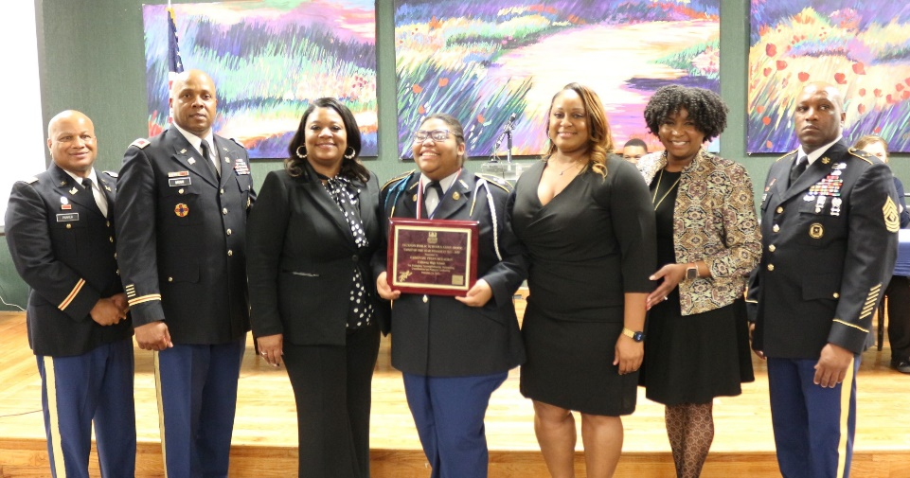
JPS JROTC Special Programs
JROTC Cadet of the Year Competition and Awards Dinner
Each school nominates their top LET III cadet to compete for this honor
The competition is conducted the first Tuesday in February annually and consist of:
Cadets appear before a 8-9 person selection panel, consisting of district administrators, military and local business personnel
Panel members will individually review a portfolio on each cadet, conduct a brief interview of each cadet and receive a five-minute briefing from each cadet
Panel members will assign scores to cadets in various areas and the cadet with the overall highest score will be designated JPS JROTC Cadet of the Year
Cadet of the Year Awards Dinner is conducted annually (February 2024) in the Miss. eCenter @ JSU
All Cadet of the Year candidates and each school’s top performing cadet for each grade level is formally recognized at this Awards Dinner

Slide 23
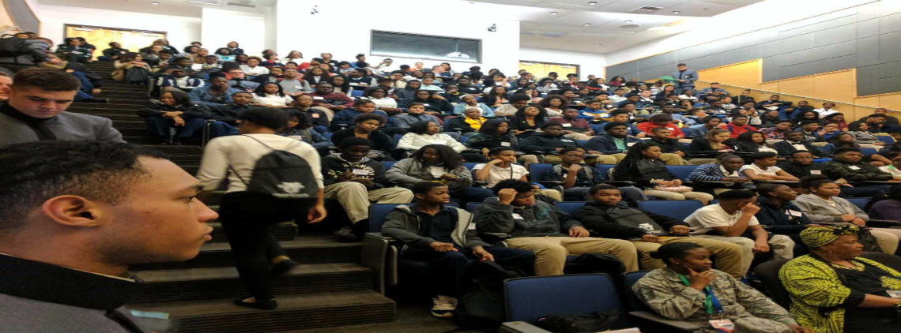
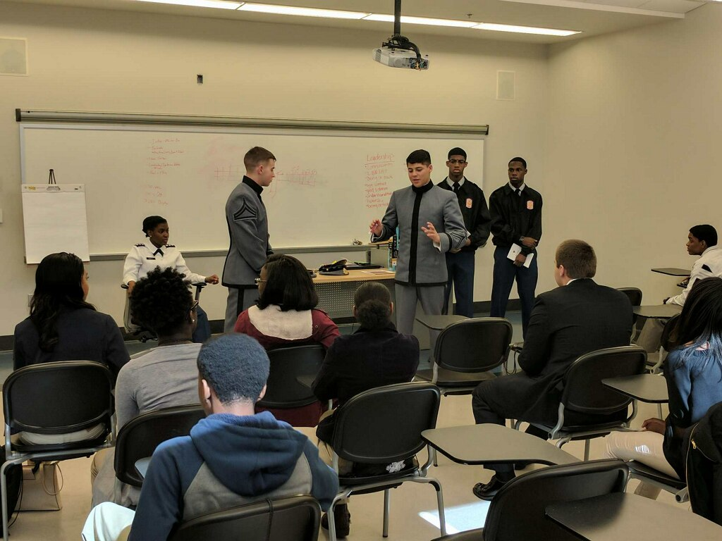
JPS JROTC STEM PROGRAM
The West Point Leadership, Ethics and Diversity Workshop at JSU – 2 February 2024
This one-day workshop is designed for students to experience and tolerate a variety of experiences that cause thought, civil discourse and teambuilding across those differences.
The intent is to expose students to concepts of STEM, hoping to inspire them toward STEM careers.
The workshop objective is to help students understand the link between ethics and STEM competence. The workshop is conducted in the Mississippi eCenter @JSU
The workshop is facilitated by cadets from West Point and JSU.
Participants include 200 JROTC cadets and 15 JPS educators.

Slide 24
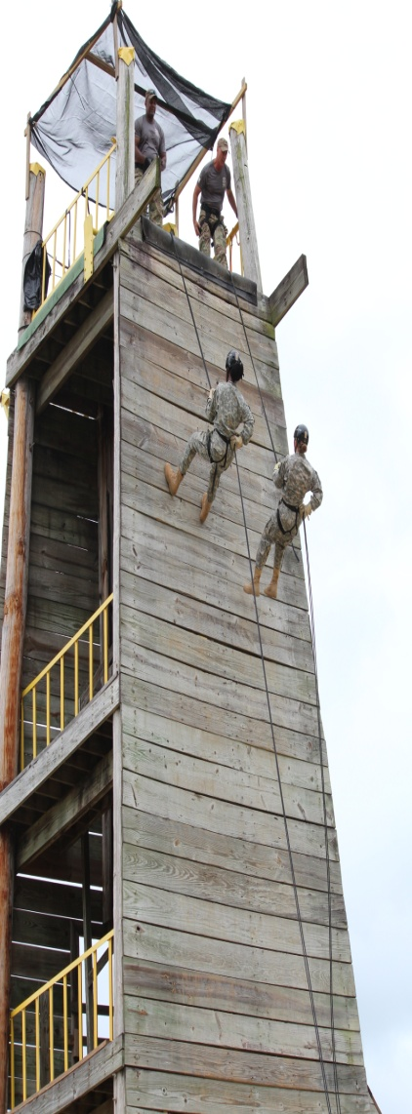
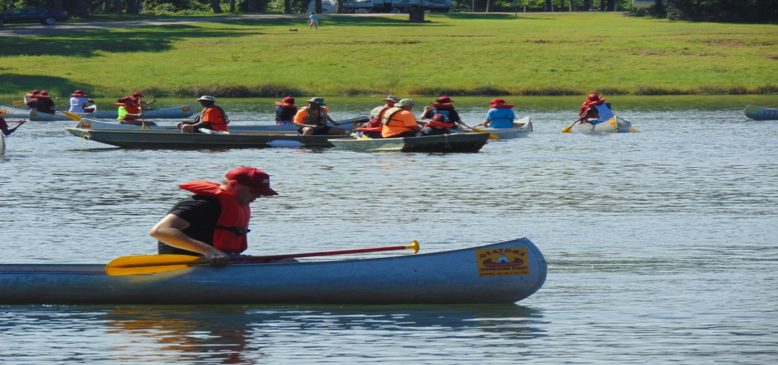
JPS JROTC Leadership Programs
JROTC Cadet Leadership Challenge (JCLC) “Summer Camp” – Focused on Adventure Training, Leadership, Team Building, Confidence, and Peer Interaction
Conducted at Camp Shelby, Hattiesburg, MS – 1-5 June 2022
Residential Program for 56 JPS cadets and 10 JROTC instructors
Sponsored by U.S. Army

Slide 25
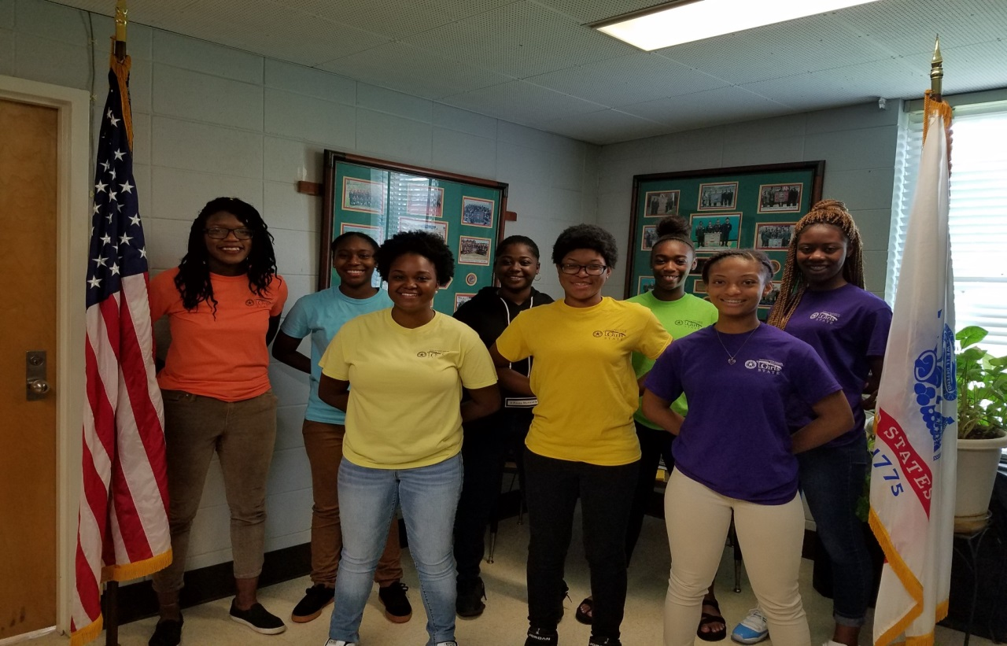
JPS JROTC Special Leadership Programs
Girls State / Boys State (Students learn about structure and responsibilities of state government)
Residential program conducted on college campus – MSU, USM or Ole Miss – 28 JPS cadets participate annually
Conducted during the months of May/June annually (6 days)
Local American Legion Post sponsors JPS cadets
JPS JROTC Girls State attendees –
University Of Southern Mississippi
JPS JROTC Boys State attendees – University Of Mississippi

Slide 26
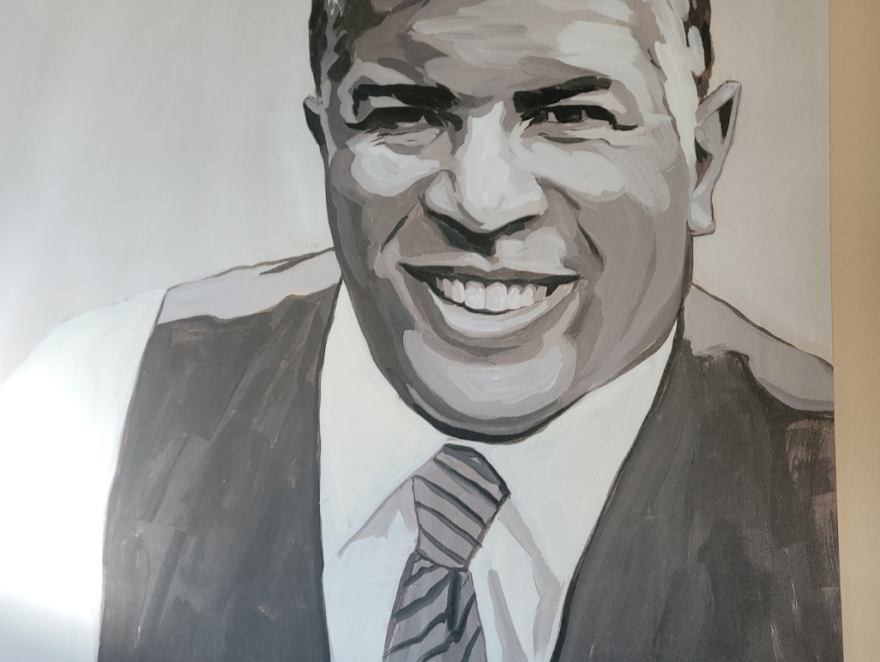
Fund II Foundation
Mission is to preserve African American experience; safeguard human rights; provide music education; preserve the environment while promoting the benefits of the outdoors; and sustain critical American Values such as Entrepreneurialism.
Philanthropy
Mr. Robert Smith, Founder of Fund II Restoration Retreat

Slide 27
Fund II Foundation Classes
Entrepreneurship
Financial Literacy
Dental Hygiene
Public Service
Myers Briggs Personality Test
STEM /Coding and Robotics
Future of Artificial Intelligence
Genealogy
Internal and External Motivation
Leadership

Slide 28
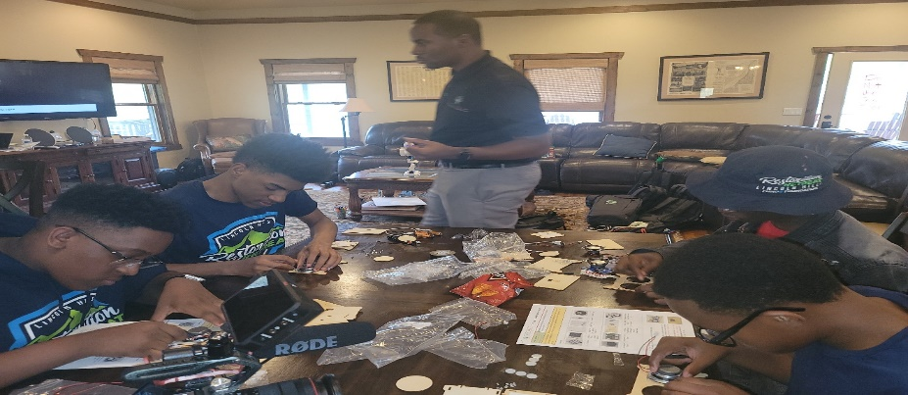
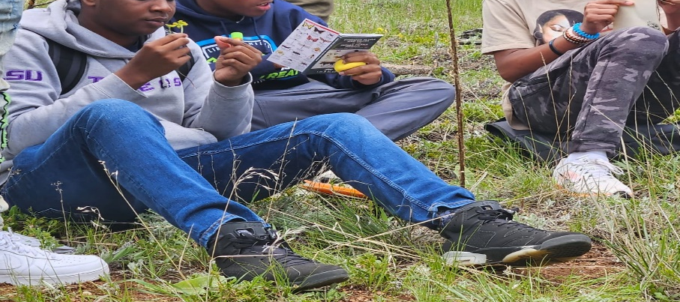
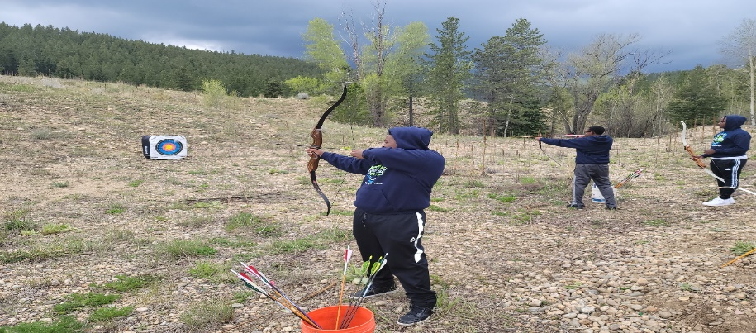
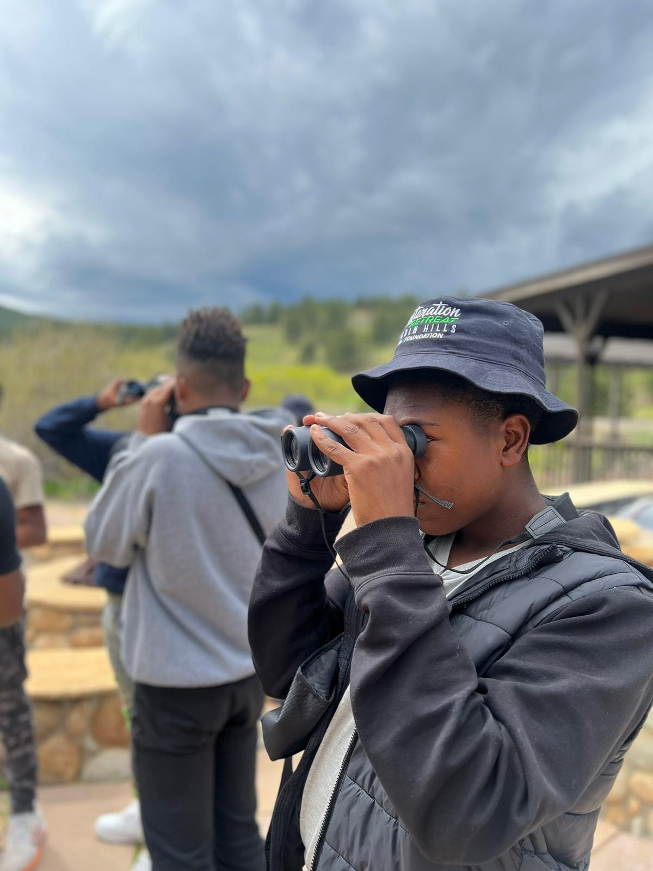
Fund II Foundation Classes Cont.
Restoration Retreat Putting together a Bluetooth Speaker
Retreat Plant Identification
Archery
Bird Watching

Slide 29
In Conclusion
Instructors are the most essential component of JROTC
The positive impact of JROTC on cadets is demonstrated by our graduates and exposing them to STEM and life after high school
JROTC is a leadership program contributing to student development, families, schools, and communities
JPS fully supports JROTC instructors, students, STEM programs, and all events

